Slide 1
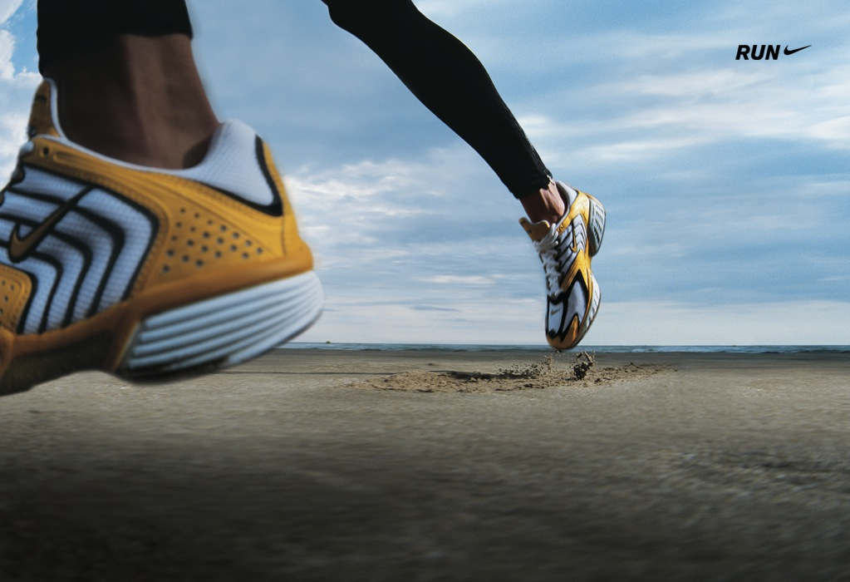
Final Project for Marketing Analysis and Planning MKTG 742-002
Internal and External Marketing Planning and Analysis of Nike Running Shoes
Submitted to
Prof. Kirk Celeste
By Team 4
Kunfayat Adekanmbi
Neeraj Mehta
Sindhu Chakravaram
Shola Fabiyi
Submitted on: August 2023

Slide 2
Agenda
1
2
3
4
5
Introduction
Background
Situation Analysis
Target Group Personification
Marketing Strategy(5p’s)
6
Conclusion

Slide 3
Table of Content
Cover Page Slide 1
Table of Contents Slide 3
Introduction Slide 4
Background on the company with Problem / Opportunity Slides 5 to 9
Situational Analysis Slide 10
Target Group Personification Slide 23
Marketing Strategy Slide 60
Consumer / Customer Insight Slide 61
Positioning statement + Positioning Map Slides 62 to 63
Product (description + concept statement) Slide 70
Price Slide 76
Place Slide 102
Promotion Slide 131
Conclusion Slide 150

Slide 4
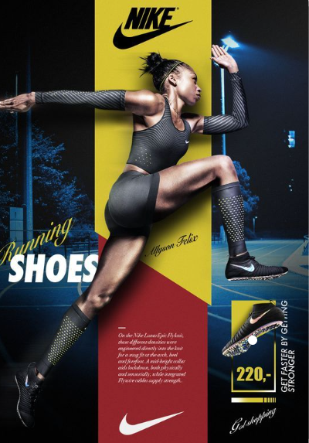
Introduction
This presentation is on Nike’s running shoes and represents an attempt to provide a situation analysis, envision analysis, and marketing mix strategy to further elevate the Nike running shoe brand above other formidable competitors in the running shoe industry.

Slide 5
Background
Nike International, a company based in Beaverton, Oregon, USA is a known name in the world of sportswear and athletic footwear. It was originally founded as "Blue Ribbon Sports" in 1964 by Bill Bowerman and Phil Knight before adopting the name Nike in 1971.
Renowned for its top-notch products Nike has become a leading brand in athletic footwear, apparel, and equipment. The iconic "Swoosh" logo is synonymous with performance, style, and athletic accomplishments.
Nike holds a position across sports and offers a diverse range of product lines including running shoes, basketball shoes, soccer cleats, and more. With a focus on innovation, technology, and design principles; the company has successfully captivated athletes and consumers globally.
However, Nike's running shoe brand has recently encountered heightened competition from established footwear manufacturers and emerging niche brands specializing in running shoes. Some of these competitors may be enticing price customers by offering priced alternatives without compromising on quality; thereby diverting their attention away, from Nike.

Slide 6
Background
Background In addition, the market, for running shoes has reached a stage, which presents challenges in maintaining growth. To overcome this, it is important to focus on attracting customer segments and offering product differentiation. Although Nike already has a brand image and loyal customers, there is an opportunity to expand its market share in the shoe segment by appealing to price-conscious consumers. This can be done without compromising the brand's value or sacrificing product quality. Additionally, as the health and fitness trends continue to rise, Nike can tap into customer segments by creating running shoes that cater to specific needs.

Slide 7
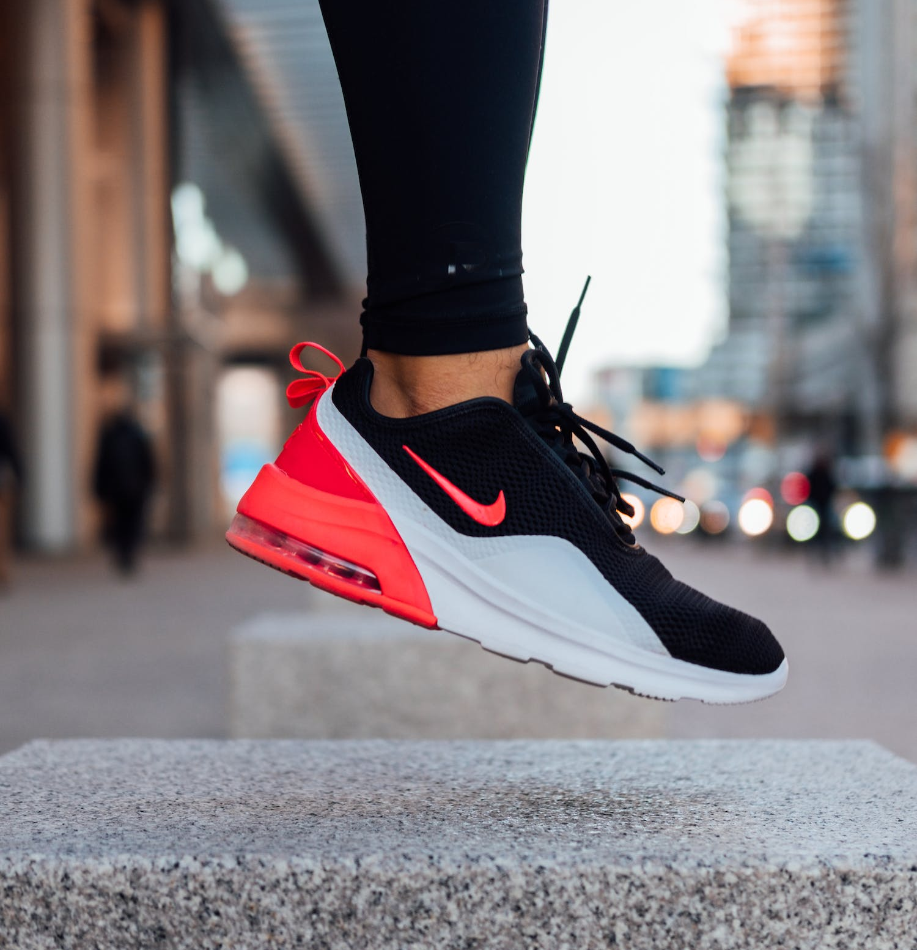
Problem Statement
The Nike Running Shoe industry faces the challenge of serving runners and customers' changing requirements and preferences while also addressing sustainability issues and retaining a competitive advantage in a continually changing market.

Slide 8
Opportunity
The Nike Running Shoe sector has the potential to harness technical breakthroughs, material and manufacturing process innovation, and customer insights to produce a new product that combines cutting-edge performance attributes, excellent comfort, and sustainability. Nike can position itself as an industry leader by creating a product that appeals to both running athletes and mindful customers.
Solution: Develop a New Nike Running Shoe Product
Develop a next-generation running shoe that provides great performance, unsurpassed comfort, and sustainability while accommodating to changing demands and preferences of running sportspersons and health-conscious customers.

Slide 9
SOLUTION: Develop a New Nike Running Shoe Product
Develop a next-generation running shoe that provides great performance, unsurpassed comfort, and sustainability while accommodating to changing demands and preferences of running sportspersons and health-conscious customers.

Slide 10
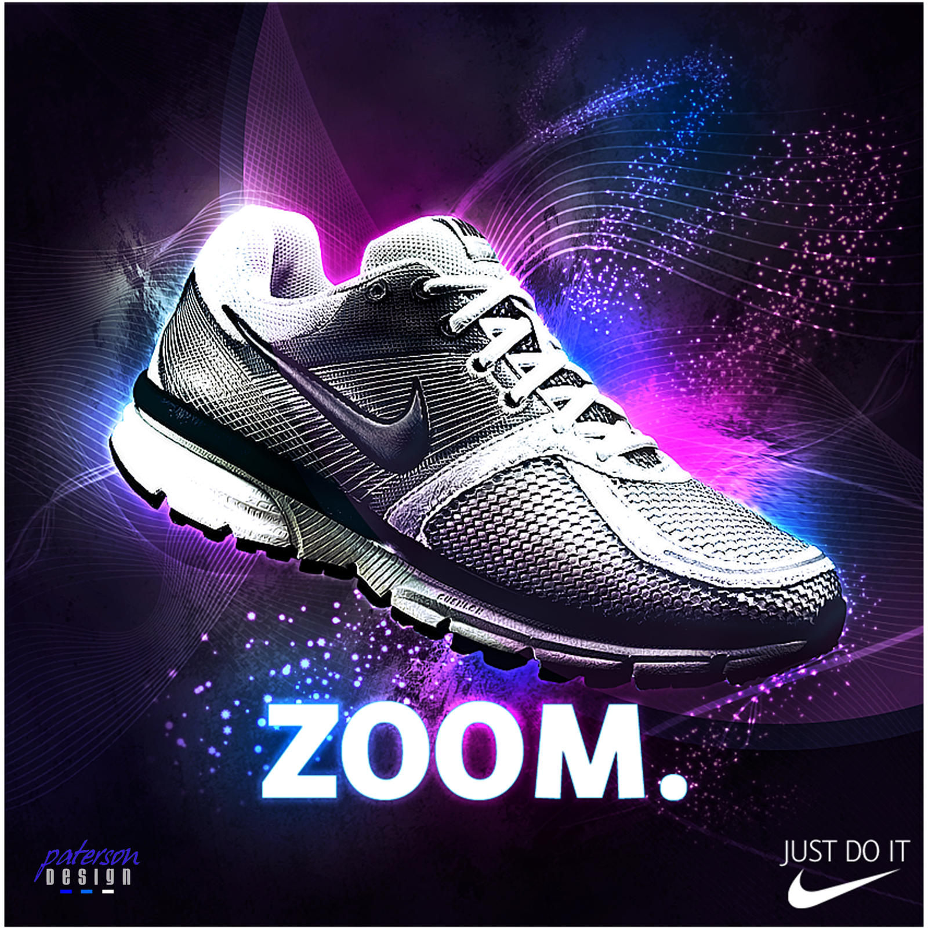

Situation Analysis on Nike Running Shoes
This Photo by Unknown Author is licensed under CC BY-NC-ND

Slide 11
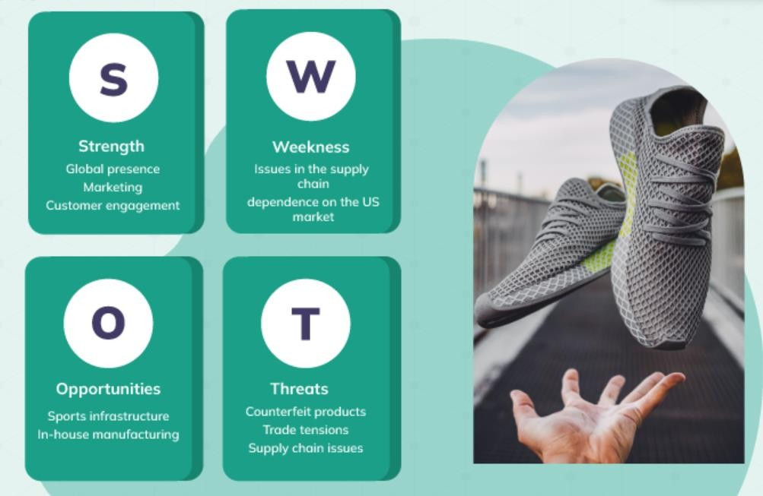
SWOT Analysis

Slide 12
Strengths: Strong brand reputation and recognition globally. Innovative technology in shoe design and materials. Extensive product line and vast distribution network. High-quality and durable products.
Weaknesses: Some products might be considered relatively expensive. Vulnerability to fluctuations in raw material costs. Reliance on fashion trends, which could impact demand.

Slide 13
Opportunities: Growing global health and fitness trends. Expansion into emerging markets with increasing disposable income. Diversification into other sports-related products.
Threats: Intense competition from other running shoe brands. Economic downturns affecting consumer spending. Increasing concerns over sustainable and ethical practices.

Slide 14

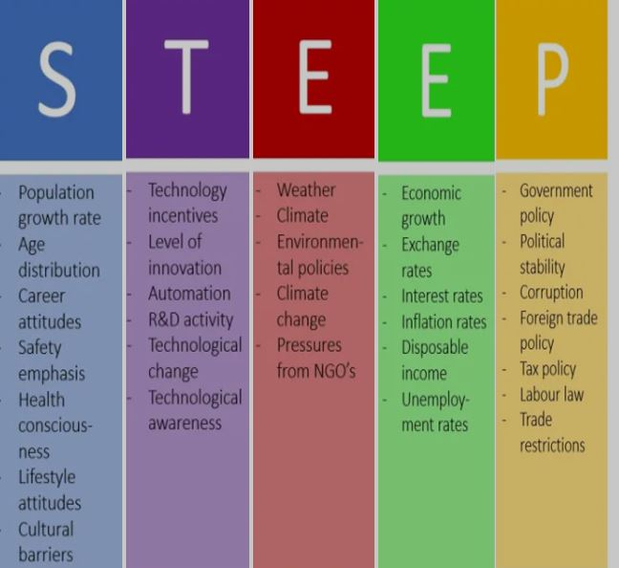

STEEP Analysis

Slide 15
Social:
Growing interest in fitness and wellness.
Changing consumer preferences for sustainable and eco-friendly products.
Technological:
Advancements in materials and manufacturing techniques.
E-commerce and digital marketing opportunities.
Economic:
Economic stability impacting consumer purchasing power.
Currency fluctuations affecting international revenues.

Slide 16
Environmental: Pressure for eco-friendly production and sustainable sourcing.
Political/Legal: Trade policies and tariffs affect international sales. Government regulations related to product safety and labor practices. Employment laws and regulations in various countries.

Slide 17
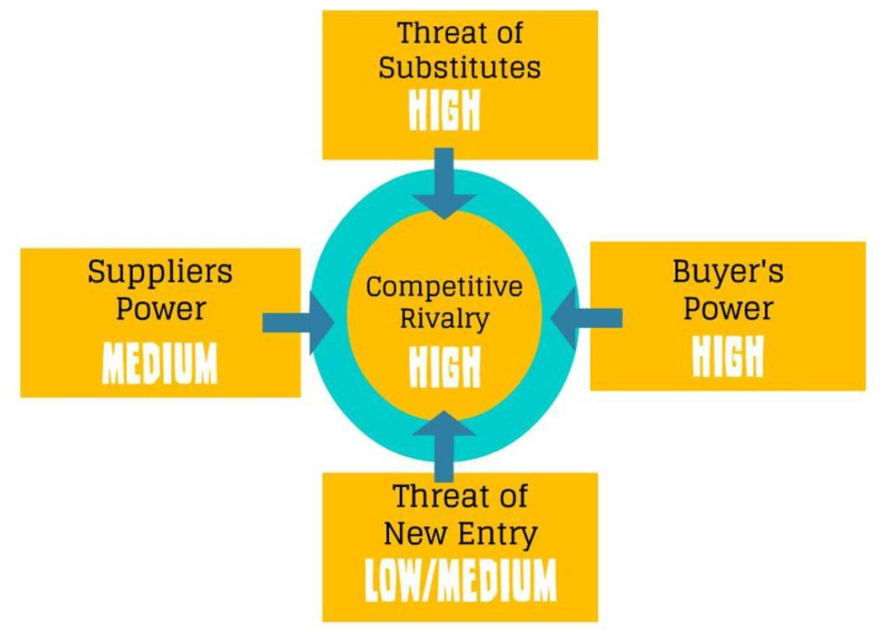
Porter’s Five Forces

Slide 18
1. Threat of New Entrants:
Low to Moderate The running shoe industry requires significant investments in research and development, brand building, and marketing to compete effectively. Nike's strong brand presence and customer loyalty act as barriers for new entrants. Additionally, economies of scale and established supplier relationships give Nike a competitive advantage. However, there are relatively smaller brands that cater to niche markets and could pose a moderate threat.

Slide 19
2. Bargaining Power of Suppliers:
Moderate/Medium Nike works with a network of suppliers globally. The bargaining power of suppliers is somewhat moderate due to the availability of alternative suppliers in different regions. However, Nike's scale and reputation enable the company to negotiate favorable terms with suppliers and maintain consistent quality in its products.

Slide 20
3. Bargaining Power of Buyers:
High Customers have high bargaining power in the athletic footwear market, including running shoes. The market is highly competitive, with many brands offering similar products. Customers can easily switch between brands based on factors such as price, design, and features. Nike's success in retaining customers lies in its ability to differentiate its products and create strong brand loyalty.

Slide 21
4. Threat of Substitutes:
High
The running shoe market faces significant competition from substitute products such as casual footwear and sports sandals. To address this threat, Nike focuses on innovation and marketing to position its running shoes as premium, performance-oriented and stylish options for runners and fitness enthusiasts.

Slide 22
5. Competitive Rivalry:
High
The competition in the running shoe market is intense, with major brands like Adidas, Under Armour, and Reebok vying for market share. Nike's ability to stay ahead of the competition depends on its continuous product innovation, strong marketing campaigns, the sustainability of its image as a quality running shoe manufacturer, and strategic partnerships with athletes and sports teams.

Slide 23
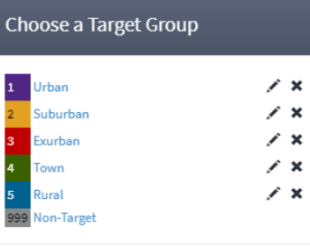
Target Group Personification

Slide 24
The rationale behind this grouping is to identify different target segments based on common characteristics, high income, diversity, preferences, and needs. By understanding these segments and tailoring its marketing efforts accordingly, Nike can effectively reach and connect with these specific consumer groups.

Slide 25

Target Group 1: Affluent and Sophisticated
The A-list, Wealthy and Wise, and Asian Sophisticates segments share common traits of wealth and sophistication.
They represent people with higher incomes and sophisticated tastes in lifestyle choices.
These segments are more likely to prioritize quality, luxury and exclusivity in their buying decisions.
By targeting this group, Nike can position itself as a premium brand with high-quality products tailored to their discerning preferences.

Slide 26
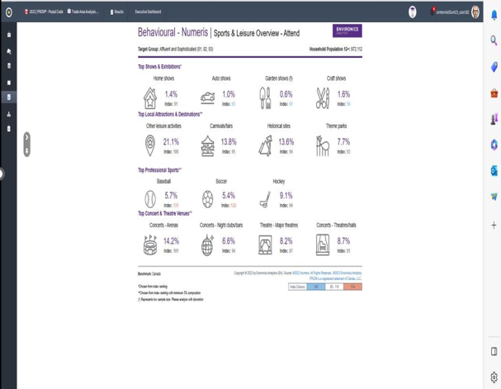
Data from Envision

Slide 27

Sports & Leisure Overview – Attend
Top Shows & Exhibitions
Home Shows:​
Affluent and Sophisticated: Fair interest (1.4%)
Compared to average (Index; 91)
Not highly inclined toward home improvement and interior design events
Auto Shows
Target group: Lower interest (1.0%)
Compared to average (Index; 65)
Auto Shows not a preferred leisure activity considering background

Slide 28
Variable 1: Sports & Leisure Overview – Attend
Garden Shows:​
Craft Shows:
Target group: Some interest (0.6%)
Compared to average (Index; 61)
Garden shows not a primary focus for affluent segment
Target group: Significant interest (1.6%)
Compared to average (Index; 59)
Interested in handmade and artisanal products, likely to attend Craft Shows

Slide 29
Top Professional Sports
Baseball: Affluent and Sophisticated attendees show high interest (5.7%) in baseball games (Index: 131), indicating strong affinity.
Soccer: Affluent and Sophisticated group demonstrates elevated interest (5.4%) in soccer matches (Index: 122), highlighting diverse sports interest.
Hockey: Affluent and Sophisticated segment displays moderate interest (9.1%) in hockey games (Index: 94), suggesting a balanced engagement level.

Slide 30
Top Local Attractions & Destinations:
Concerts - Arenas​
Theatre - Major Theatres
Concerts - Nightclubs/bars
With a representation slightly above average (14.2%) when measured against the benchmark (Index: 101).
This portrays a higher interest in attending concerts performed in arenas, indicating a fondness for large-scale music events
Under this activity the target group shows a slightly above average (6.6%) when measured against the benchmark (Index: 94).
This suggests a moderate interest in attending concerts in nightclubs and bars, reflecting a preference for intimate and exclusive music experiences.
The “Affluent and Sophisticated” have a representation slightly below average (8.2%) in contrast to the benchmark (Index: 87).
This signifies a moderate interest in showing up at performances in major theatres, suggesting an appreciation for theatrical arts but with a relatively lower frequency

Slide 31
Variable 2: Sports & Leisure Overview - Participate
Target group: Affluent and Sophisticated
Preferences & Interests:
Downhill skiing (20.1%) Racquet sports (16.2%)
Baseball/softball (15.3%) Basketball (17.0%)
Arts/crafts (44.1%) Volunteer work (43.1%)
Photography (32.2%) Reading (82.5%)
Pilates/yoga (24.0%) Health club activities (22.6%)
Fitness classes (27.1%) Home exercise (63.2%)

Slide 32
Key Findings:
Affluent and Sophisticated segment is engaged in diverse recreational activities.
High participation in arts, crafts, volunteer work, reading, and home exercise.
Interest in downhill skiing, racquet sports, baseball/softball, and basketball.
Strong commitment to physical fitness and well-being, evident in Pilates/yoga, health club activities, and fitness classes.

Slide 33
Variable 3: Media Highlights Analysis
Target group: Affluent and Sophisticated
Demographic Statistics:
Household Population 14+: 945,978 individuals
Television:
Viewership: Light viewing (53.43%), medium viewership (30.86%).
Preferred Programme Types: News/current events (52.32%), situation comedies (42.64%).

Slide 34
Variable 3: Media Highlights Analysis
Radio:
Listenership: Heavy listenership (52.16%).
Preferred Formats: News/talk (38.60%), alternative rock (30.64%).
Newspaper:
Print Readership: Light print (65.64%).
Digital Readership: Computer (28.59%) preferred over smartphones (23.88%).

Slide 35
Variable 3: Media Highlights Analysis
Internet Usage:
Most common usage: 2 to 4 hours (34.45%).
Websites Preferences:
Engaged in maps/directions (50.06%), food/recipes (47.03%), health (29.98%), and sports-related websites (29.18%).
This corresponds to their rich and sophisticated lifestyle, in which they seek knowledge, pursue luxurious hobbies, prioritize health, and watch sporting events.

Slide 36
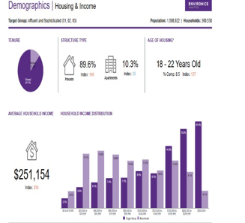
Fig 1.1 Data from Envision

Slide 37
Variable 4: Housing and Income Analysis
Population:
Total population: 1,098,922
Households: 360,538
Represents a smaller, high-income segment
Tenure:
Ownership: 87.7%
Communal homeownership propensity
Leased or rented: 12.3%

Slide 38
Variable 4: Housing and Income Analysis
Structure:
Houses: 89.6%
Apartments: 10.3%
Age of Housing:
Houses relatively recent
18 to 22-year-old category: 8.5% (Index: 137)
Preference for newer residences
Household Income:
Average income: $251,154 (Index: 216)
Concentration in upper-income category
Higher percentage above $300,000
Reflects wealth and sophistication

Slide 39
Target Group 2: Multi-Culture Communities
The Turbo Burbs, Multi culture Ish, and South Asian Enterprise segments encompass a range of communities, with cultural backgrounds.
These communities are known for their multiculturalism, the blending of traditions, languages, and ethnicities.
By catering to these groups Nike can highlight the importance of inclusivity and diversity, in its marketing tactics and product lineup.
Nike can demonstrate its dedication to representing and honoring cultures, which can deeply connect with these segments and cultivate a sense of belonging among its members.

Slide 40
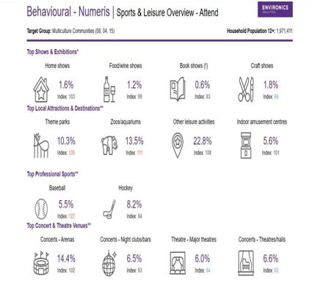
Fig 2.0 Data from Envision

Slide 41
Variable 1: Sports & Leisure Overview – Attend
Population:
Shows and Exhibitions Attendance
Sports and Entertainment
Local Attractions and Destinations
Theme parks: 10.3%
Zoos and aquariums: 13.5%
Broad interest in leisure activities: 22.8%
Indoor amusement centres: 5.6%
Wide range of interests within the target group
Popular sports:
Baseball: 5.5%
Hockey: 8.2%
Popular concert/theatre venue: Arenas (14.4%)
Reduced interest in:
Concerts at nightclubs/bars
Multiculture Communities Target Group
Household population: 1,971,411 individuals aged 12 and above
Diverse group with unique statistics, behaviors, and preferences
Home shows: 1.6%
Food/wine shows: 1.2%
Craft fairs: 1.8%
Book fairs: 0.6%
Moderate interest in shows and exhibitions

Slide 42
Variable 2: Sports & Leisure Overview - Participate
Individual Sports:
Downhill skiing: 19.6% (Index: 112)
Skateboarding: 5.5% (Index: 126)
Martial arts: 5.1% (Index: 113)
Bowling: 36.3% (Index: 108)
Team Sports:
Basketball: 18.9% (Index: 126)
Football: 15.5% (Index: 112)
Baseball/softball: 15.4% (Index: 118)
Soccer: 8.4% (Index: 131)

Slide 43
Variable 2: Sports & Leisure Overview - Participate
Activities:
Video games: 46.5% (Index: 115)
Ice skating: 32.0% (Index: 108)
Photography: 31.5% (Index: 101)
Volunteer work: 41.4% (Index: 100)
Fitness:
Home exercise: 65.5% (Index: 108)
Health club: 23.3% (Index: 113)
Fitness classes: 25.9% (Index: 103)

Slide 44
Variable 3: Media Highlights Analysis
Television
TV viewership: 53.57% "light" (Index: 110)
Popular program types:
Situation comedies: 45.41% (Index: 108)
Food shows: 35.70% (Index: 107)
Other popular programs:
Reality TV, stand-up comedy: 15.09% (Index: 77)
Radio
Strong listenership: 52.54% "heavy" (Index: 106)
Top radio formats:
Traffic-related: 15.99% (Index: 139)
Jazz: 12.13% (Index: 129)
Sports: 15.26% (Index: 128)
Favorites: Rap, hip-hop

Slide 45
Variable 3: Media Highlights Analysis
Internet
High internet usage:
2-4 hours: 31.64% (Index: 90)
6 hours: 22.28% (Index: 124)
Popular online activities:
Entertainment websites: 53.49% (Index: 110)
Maps/map directions: 49.04% (Index: 102)
Food/recipes: 46.80% (Index: 106)
Online purchases:
Electronics: 22.58% (Index: 111)
Footwear: 20.92% (Index: 117)
Newspaper
Print readership: 8.00% "heavy" (Index: 123)
Most-read print sections:
Home/real estate: 7.98% (Index: 153)
Fashion/leisure: 7.41% (Index: 146)
Sports: 11.30% (Index: 125)
Digital reading:
Online news via PCs: 26.55% (Index: 109)
Online news via smartphones: 28.75% (Index: 108)

Slide 46
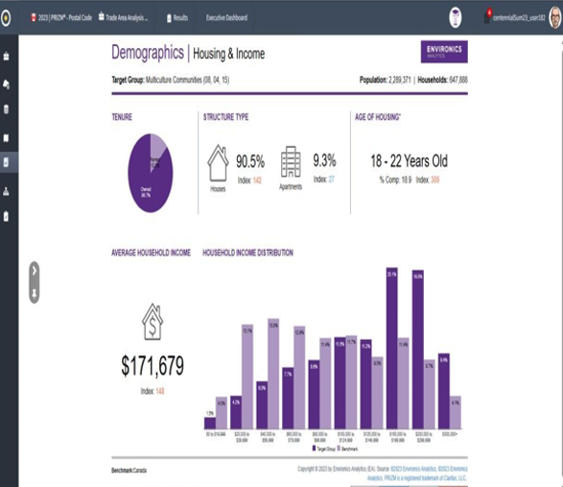
Fig 2.1 Data from Envision

Slide 47
Variable 4: Housing and Income Analysis
Tenure:
86.7% of Multicultural Communities members own homes.
13.2% of households are rented.
Structure:
90.5% of residences are houses.
9.3% are rented apartments.
Age of Housing:
18-22 years old housing: 18.9% (Index: 305).
Preference for newer residences and modern features.
Household Income:
Average income: $171,679 (Index: 148).
Concentration in higher income categories.
Significant shares in $150,000-$199,999 and $200,000-$299,999 categories.

Slide 48
Target Group 3: Urban Professionals
These people tend to be wealthy, busy, career-oriented, and lead fast-paced lifestyles.
In their choice, they value convenience, uniqueness, style, and functionality.
By targeting this group, Nike can position its running shoes as the perfect solution for their active lifestyle.
Nike can emphasize features such as comfort, performance, and versatility by emphasizing that its running shoes are designed to meet the needs of Urban professionals seeking style and functionality.

Slide 49
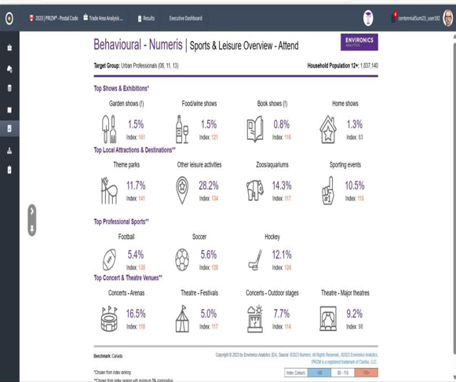
Fig 3.0 Data from Envision

Slide 50
Variable 1: Sports & Leisure Overview – Attend
Population: Urban Professionals’ target group has a home population of 1,837,140 people.
Shows Attendance:
Garden events, food/wine exhibits, book displays, and house shows each attract approximately 1-1.5% of the target group.
Local Attractions and Destinations:
Theme Parks: 11.7% of Urban Professionals
Zoos/Aquariums: 14.3% of Urban Professionals
Sports Attendance:
Sporting events attract 10.5% of the target demographic.
Hockey games: 12.1% of Urban Professionals (most popular), followed by football and soccer.
Concerts and Theatre Venues:
Arena concerts: 16.5% attendance rate among Urban Professionals.
Theatre festivals: 5% attendance.
Outdoor concerts: 7.7% attendance.
Big theatres: 9.2% attendance.

Slide 51
Variable 2: Sports & Leisure Overview - Participate
Individual Sports:
Notable participation percentages: Racquet sports (16.7%) and downhill skiing (20.3%).
Cycling (mountain and road biking) highly popular, accounting for 50.9% of participants.
Team Sports:
Participation rates: Basketball (17.4%) and soccer (14.7%).
Hockey (14.2%) and baseball/softball (14.9%) also have notable participation.

Slide 52
Variable 2: Sports & Leisure Overview - Participate
Leisure Activities:
Ice skating: 34.1% participation rate.
Camping: 49.6% of Urban Professionals engage in outdoor camping.
Video games: 44.4% enjoy playing.
Reading: Remarkable 81.4% of Urban Professionals report reading participation.
Fitness:
Popular fitness activities: Jogging (27.4%) and fitness classes (27.2%).
Health club participation: 22.3%.
Home exercise favored by majority (64.0%), emphasizing convenience and flexibility.

Slide 53
Variable 3: Media Highlights Analysis
Television
Viewership: Light (55.84%), Medium (29.52%), Heavy (14.63%)
Top Program Categories: Sports (39.97%), Sci-Fi/Fantasy (35.76%), Cookery (35.00%), Wildlife (30.32%)
Print Media
Newspaper Readership: Light (67.55%), Medium (9.46%)
Digital Media
Smartphone Internet Usage: 32.65%
Radio
Urban Professionals: 49.15% strong listenership
Listenership: Strong (49.15%), Medium (29.72%), Light (21.12%)
Preferred Formats: News/Talk (33.01%), Top 40 (31.25%), Alternative Rock (30.08%)
Magazines
Printed Magazines: 53.42%
Digital Magazines: 42.00%
Popular Periodicals: Food/Recipes (18.82%), Home Décor (11.08%), Technology/Science (10.72%), Travel/Tourism (10.69%)

Slide 54
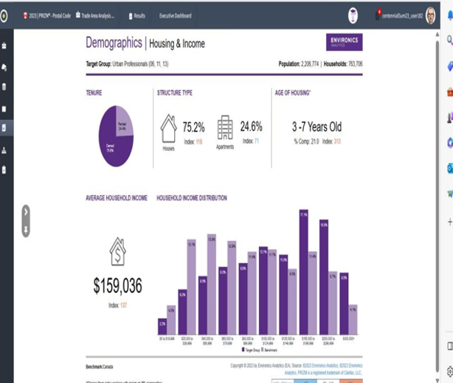
Fig 3.1 Data from Envision

Slide 55
Variable 4: Housing and Income Analysis
Tenure Preferences:
Owned properties preferred by 75.6% of households
Renting is preferred by 24.4%
Housing Structure Distribution (Owned):
Houses: 75.2%
Rental apartments: 24.6%
Age of Housing Preference:
21.0% of housing is 3-7 years old
Household Income:
Average: $159,036
Skewed towards higher income brackets:
$150,000 - $199,999: 17.14%
$200,000 - $299,999: 15.76%
$100,000 - $124,999: 12.07%

Slide 56
Variable 4: Housing and Income Analysis
1. Financial Situation:
Urban Professionals have a higher average income
More affluent financial situation
2. Housing Preference and Affordability:
Prefer house ownership over renting
Favor houses over apartments
Able to invest in and maintain homes due to higher income
Strong prevalence in higher income groups, indicating financial security.
Age of Housing:
18-22 years old housing: 18.9% (Index: 305).
Preference for newer residences and modern features.
Household Income:
Average income: $171,679 (Index: 148).
Concentration in higher income categories.
Significant shares in $150,000-$199,999 and $200,000-$299,999 categories.

Slide 57
Variable 4: Housing and Income Analysis
Age of Housing:
18-22 years old housing: 18.9% (Index: 305).
Preference for newer residences and modern features.
Household Income:
Average income: $171,679 (Index: 148).
Concentration in higher income categories.
Significant shares in $150,000-$199,999 and $200,000-$299,999 categories.

Slide 58

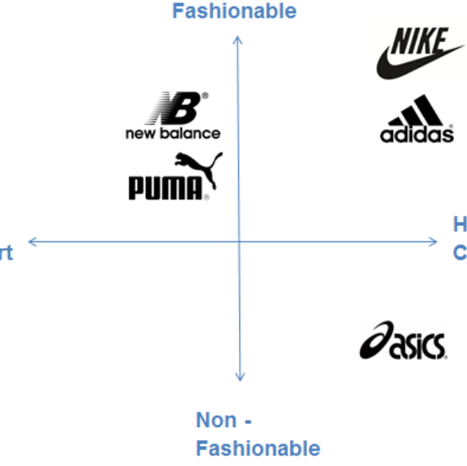

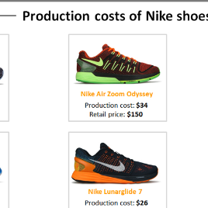
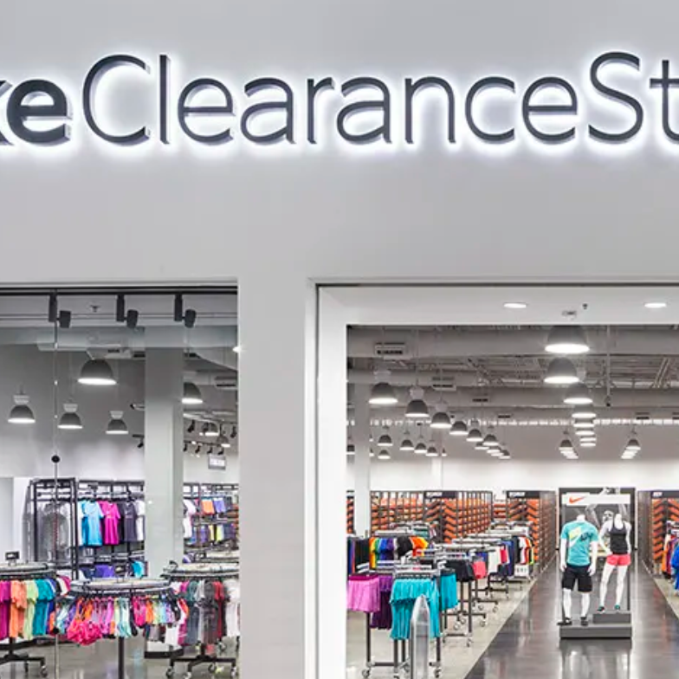
Marketing Strategy
Consumer / Customer Insight
Positioning statement + Positioning Map
Product (description + concept statement)
Price
Place and Promotion

Slide 59
Consumer Insights Consumer Insight statement helps organizations to listen to, comprehend and satisfy the mind, desires, needs, wants, and aspirations of their consumers. Consumer Insight Statements on Nike running shoes: “I have been searching for a running shoe that does not sacrifice sustainability with superior performance. Nike running shoe aligns with both values as I am satisfied knowing that my choice of running shoe contributes to reducing waste and environmental impact” "In need of running gear that fits with my desire to make eco-friendly purchases without losing performance, I discovered satisfaction in Nike's sustainable lines of running shoes." "As someone who runs in different weather and terrain conditions, I need shoes that can handle it all. I found that Nike's running shoes with adaptive traction technology provide the stability and grip I require, regardless of where I'm running. "I need a running shoe that combines style and functionality that is borne in svelte designs with technical features, I have found my Nike running shoe as a perfect fit for this"

Slide 60
Positioning Statement and Positioning Map
Statement
The Nike brand positioning statement is as follows:
“For athletes in need of high-quality, fashionable athletic wear, Nike provides customers with top-performing sports apparel and shoes made of the highest quality materials. Its products are the most advanced in the athletic apparel industry because of Nike’s commitment to innovation and investment in the latest technologies.
Nike has used this straightforward positioning statement as a road map to produce a variety of marketing strategies and products amongst which are Nike running shoes
The team makes use of this positioning statement in every marketing strategy created by the business to make sure they are communicating with their consumers effectively.
Map
Nike's positioning map specifically sets the running shoe brand at the pinnacle of innovation and responsibility, with the X-axis indicating a trailblazing approach to sustainability and the Y-axis showing a persistent dedication to technical performance. By showcasing a brand that promotes both athletic achievement and environmental sustainability, this connection raises the bar for the running shoe industry.

Slide 61
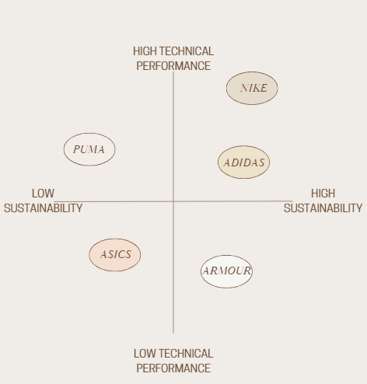
Nike’s Positioning Map

Slide 62
Elements of Nike’s Positioning Strategy
The core elements of Nike’s running shoe positioning strategy are the brand’s unique selling points (USP) and they are as follows:
Technical Performance: Nike emphasizes and demonstrates that it is focused on providing shoes with the best possible performance by utilizing advanced technology, innovation, and quality materials.
Sustainability: By incorporating eco-friendly materials and processes, Nike demonstrates to consumers its genuine commitment to reducing the environmental impact of its running shoe
Brand Prestige: Nike's reputation as a leading athletic brand helps position its products as premium and a trustworthy brand in the mind of consumers.
Customer Focus: Nike reiterates that its pride itself in understanding and meeting the unique needs and preferences of its target customers
Innovation: Continuous investment in research and development ensures that Nike stays ahead in delivering cutting-edge technology in its footwear.

Slide 63
Positioning Statement for a new Nike running shoe
The newest running shoe from Nike embraces sustainability with eco-friendly materials and provides optimum performance thanks to cutting-edge technology and sole science. A good option for today’s runners who appreciate both excellence and environmental responsibility.

Slide 64
Positioning Strategy for a new Nike running shoe
Below are some potential positioning strategies for a new Nike running shoe:
Innovation and Technical Superiority: The new Nike running shoe should emphasize the shoe's cutting-edge technology and design that provides unmatched performance for runners.
Sustainability and Environmental Responsibility: Nike should position the shoe as eco-friendly, utilizing recycled materials and sustainable manufacturing processes.
Health and Wellness Focus: Highlight the shoe's technical performance features that support a healthy and active lifestyle, including ergonomic design.
Premium Quality with Social Responsibility: Nike should reiterate the exceptional quality and craftsmanship of the new running shoe while underlining ethical sourcing and fair labor practices.

Slide 65
Product From track spikes and racing shoes to daily trainers and trail shoes, Nike has a wide selection of running shoes. The Nike running shoe product offers a padded-yet-responsive ride that is cozy and energetic underfoot. Nike running shoe products are known for special features, high-quality manufacturing process, sole science, and unique packaging.

Slide 66
Product Descriptions
Innovative Designs
This includes the iconic Swoosh logo, which symbolizes quality, movement, and speed.
Wide Range of Products
The company offers a wide range of products, including running shoes, clothing, and accessories.
Advance Shoe technology
Nike incorporates advanced performance technologies, such as Nike Air cushioning,
Dri-FIT fabric, and Flyknit technology, to enhance performance.
Customization
NikeID customization allows customers to personalize their footwear and apparel,
Membership
NikePlus membership offers personalized product suggestions and early access
to training programs.

Slide 67
Quality and Technology
Nike emphasizes that its running shoe products are made through a highly-quality manufacturing process, premium materials, and quality testing.
Nike running shoes feature advanced technologies, rigorous testing, and top-notch materials to enhance performance, comfort, and durability.
Materials
Nike uses materials based on specific running requirements and offers warranties and returns.
Concept Statement of Nike running shoe
"Nike running shoes combine state-of-the-art technology and premium materials to deliver peak performance for runners of all abilities. Our shoes are engineered to provide excellent cushioning, stability, and support, enhancing the running experience while reducing the risk of injuries. With a wide range of styles and colors, Nike running shoes empower athletes to express their unique style while achieving their fitness goals."

Slide 68
Concept Statement of Nike running shoe
"Nike running shoes combine state-of-the-art technology and premium materials to deliver peak performance for runners of all abilities. Our shoes are engineered to provide excellent cushioning, stability, and support, enhancing the running experience while reducing the risk of injuries. With a wide range of styles and colors, Nike running shoes empower athletes to express their unique style while achieving their fitness goals."

Slide 69
Nike's Running Shoe and Sustainability
A popular sports magazine, Canadian Running stated that "Manufactured materials make up about 70 percent of Nike’s total carbon footprint, and right now they are innovating and scaling to lower their use of carbon material. Nike plans on taking a circular approach to achieve its goal, by focusing on eliminating waste and creating products that are better for our planet and athletes.
Alphafly NEXT % is Nike’s top-of-the-line running shoes that are popular among long-distance runners (including record-breaking marathoner Eliud Kipchoge). Made from 50% total recycled content (by weight), this latest addition to the line places as much of an emphasis on more environmentally friendly production as on athletic performance.

Slide 70
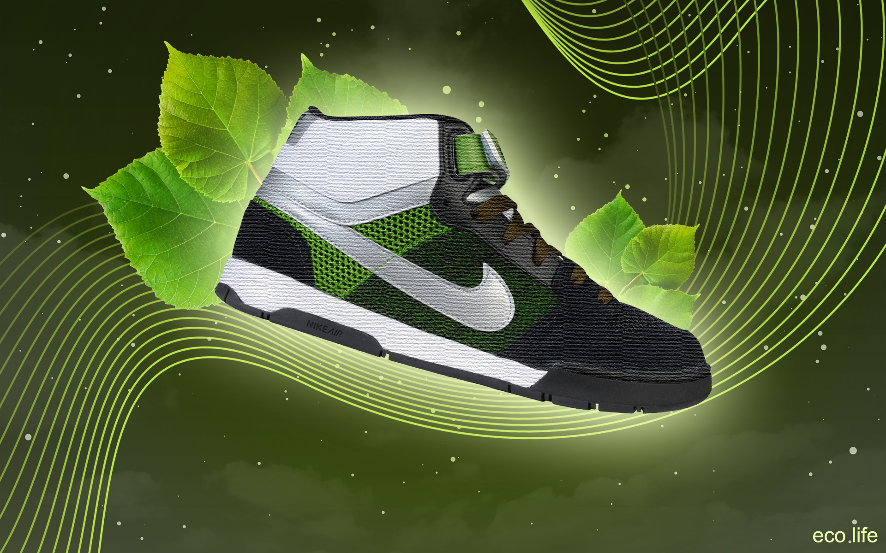
Our New Running Shoes.
The Nike GreenStride Runner reflects:
Sustainability
Composition: 80% recycled materials
We align our shoe with environmental responsibility without sacrificing quality by using:
Recyclable plastics,
Renewable rubber,
Organic cotton.

Slide 71
Technology
Cushioning: Cutting-edge foam technology generated from renewable resources delivers superior support and comfort.
Fit: The adaptable fit, which incorporates feedback from elite athletes, enables precise alignment with a variety of foot shapes.
Durability: Our unique weaving technique ensures that the shoe is both durable and lightweight.
Nike's commitment to innovation and sustainability is reflected in this sleek and futuristic design.
The Nike GreenStride Runner is a step towards a greener future without losing the performance that athletes require. Let's take the next step together.

Slide 72
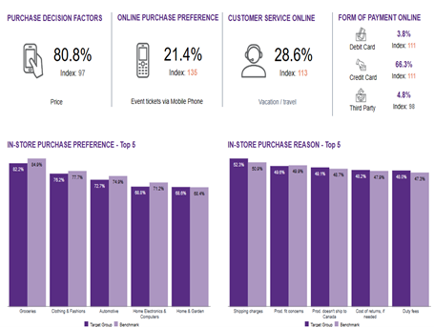
Price
The Urban Professional target group is very disposed to purchasing and using expensive-premium running shoes such as the Nike brand.
Data from Envision indicates that this group also attends and participates in sports/leisure-related activities.
More so, within this target group, 52.3% are very conscious of shipping charges and would prefer in-store purchases.
Furthermore, the price of any sports/exercise-related item such as running shoes constitutes the most important factor when purchasing the item with a percentage score of 80.8%. This means that the group is price sensitive.

Slide 73
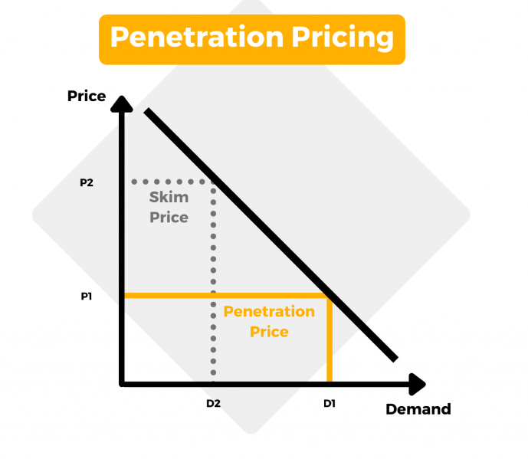
Pricing Strategies
Penetration Pricing
One effective approach would be penetration pricing – setting a price point in order to quickly penetrate the market and gain significant market share.
To tackle the challenge of rising competition and attract customers who prioritize price Nike can implement strategies. One approach is to offer pricing on running shoe models allowing them to capture a larger market share and position themselves as a more affordable choice, for runners.

Slide 74
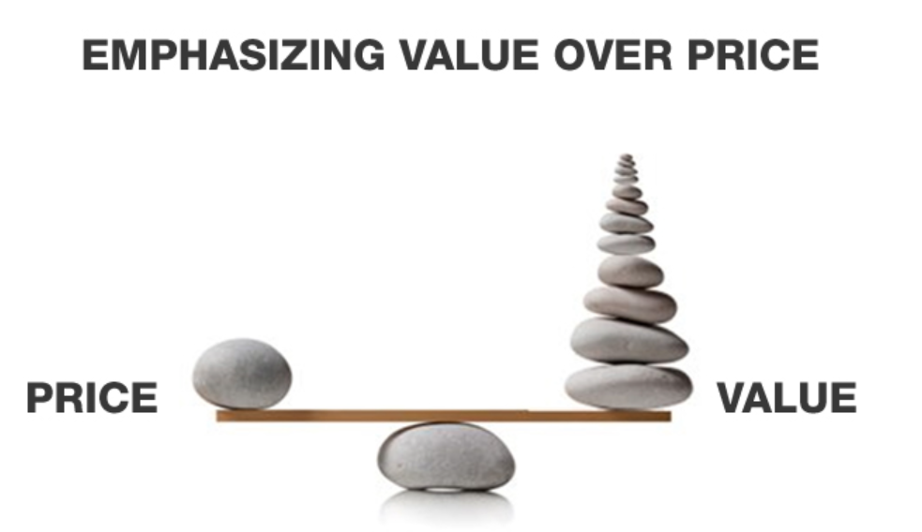
Valued-Based Pricing Another strategy is value-based pricing, where Nike can emphasize the perceived value of their running shoes by highlighting factors like technology, design, and brand reputation. By showcasing performance and unique features, Nike can justify prices for certain high-end models catering to customers who value top-of-the-line products.

Slide 75
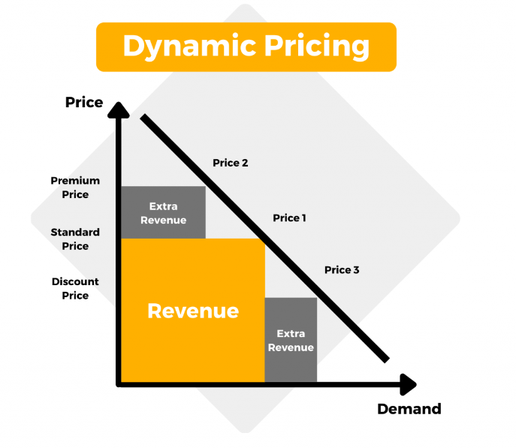
Dynamic Pricing Nike could also consider pricing for their running shoes. This involves adjusting prices in time based on market conditions demand fluctuations and other relevant factors. By implementing pricing strategies Nike can optimize revenue and profit margins by offering prices during slower periods while capitalizing on peak demand situations like major sporting events or marathon seasons.

Slide 76
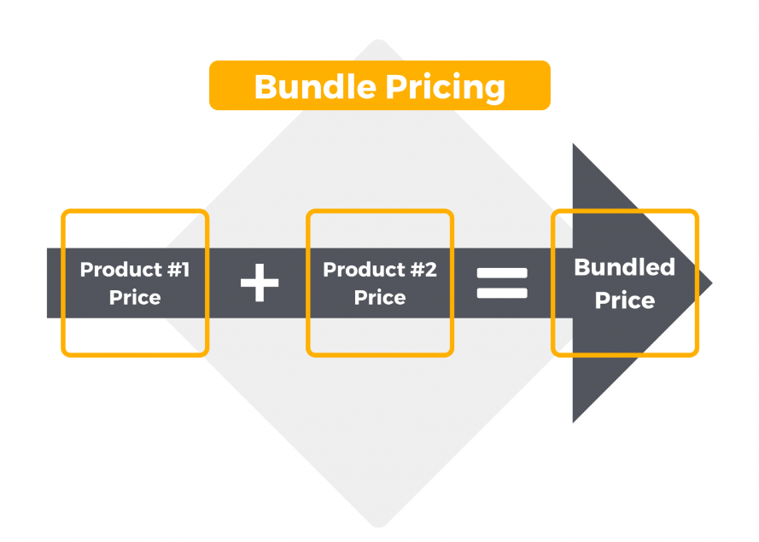
Bundle Pricing Furthermore, Nike could introduce pricing to encourage cross-selling and increase customer loyalty. For example, they could offer discounted prices on bundled packages that include running shoes along with apparel and accessories. This creates added value for customers while potentially boosting the transaction value.

Slide 77
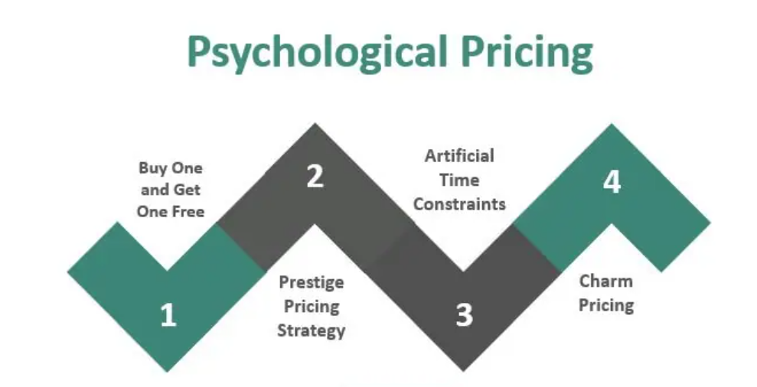
Psychological Pricing These strategic approaches would allow Nike to address increased competition effectively while attracting price customers through pricing options as well as emphasizing the unique qualities of their products through value-based pricing methods.

Slide 78
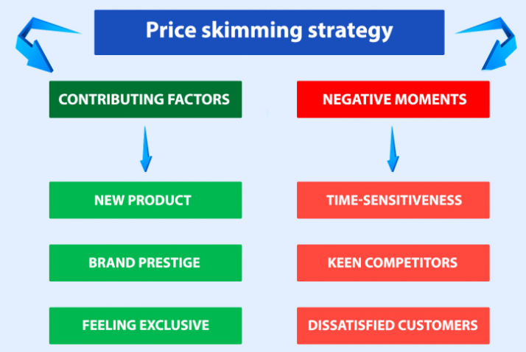
Skimming Pricing During the new phase of innovative running shoe models, Nike can use skimming pricing to capitalize on early adopters and those willing to pay a premium for the latest technology and design. As the product becomes more established, Nike can gradually adjust its pricing to attract a broader customer base.

Slide 79
Market-Based Pricing Nike can analyze the pricing strategies of its competitors and set its prices based on the market average or positioning. This approach helps maintain competitiveness in the market while also considering the unique value propositions of Nike running shoes.

Slide 80
Pricing Strategies during Nike’s Running Shoes Product Life Cycle: Introduction At the stage of launching a running shoe model, Nike can employ a strategy called "Skimming Pricing" to attract early adopters and passionate runners who are willing to pay a higher price for the cutting-edge technology and design of the product. This approach allows Nike to recover the costs of research and development while creating an image, around the new shoe.

Slide 81
Growth As the running shoe becomes more popular and accepted in the market Nike can transition to Penetration Pricing to capture a larger share of the market. By offering prices Nike can attract a range of customers leading to higher sales volume and establishing itself as a dominant player in the running shoe industry. Maturity During the maturity phase competition intensifies and concerns arise about market saturation. Nike can implement Value Based Pricing by emphasizing the technologies, comfort, and performance features of its running shoes. Additionally, Dynamic Pricing can be utilized to optimize revenue during periods and cater to varying customer demands. Decline In this phase, there might be a decline in demand for models of running shoes. To inventory, while maintaining a brand image Nike can adopt Bundle Pricing by combining these older models with newer ones. This will provide customers with added value and encourage sales of both old and new inventory.

Slide 82
Recommended Strategy: Dynamic Pricing

Slide 83
Rationale: The primary goal should be to provide a high-quality running shoe that provides great performance, comfort, and durability. Nike's reputation for innovative products and athlete sponsorships serves as an excellent platform for a value-based pricing strategy. The price might be chosen based on the perceived value that target customers place on the shoe's benefits. Market Segmentation Different market segments may interpret the shoe's value differently. Serious athletes may be willing to pay a higher price for cutting-edge technology, whereas health-conscious clients may be willing to pay a higher price for comfort and sustainability. Nike can modify rates based on these segments thanks to dynamic pricing.

Slide 84
Market Segmentation Different market segments may interpret the shoe's value differently. Serious athletes may be willing to pay a higher price for cutting-edge technology, whereas health-conscious clients may be willing to pay a higher price for comfort and sustainability. Nike can modify rates based on these segments thanks to dynamic pricing.

Slide 85
Competitor Analysis Analyze the pricing of comparable high-performance running shoes supplied by competitors. Nike should seek to position its product in line with premium offers from other companies but with a technological and feature advantage. A premium price can be justified if the product truly stands out. Differentiation A premium pricing can be set if the new running shoe combines revolutionary features, materials, or technology that provide a demonstrable advantage over older products. Customers are frequently willing to pay more for a distinctive and quality product. Innovation Customers may be ready to spend more for a shoe that is eco-friendly and constructed from sustainable materials, given the increased emphasis on sustainability. A greater price can be justified by emphasizing the shoe's environmental benefits

Slide 86
Limited Editions Introducing limited-edition versions of running shoes with distinctive styles or colors can justify a higher price because of exclusivity. Collectors and aficionados are frequently willing to pay a premium for limited-edition products. Limited Editions Implement a dynamic pricing strategy that adjusts prices based on demand, season (seasonal trends), and inventory levels. This keeps the shoe competitive while increasing revenue during peak demand periods. Bundling and add-ons Include additional products or services, such as bespoke insoles, specialized socks, or training regimens, with the purchase of the running shoe. This enables Nike to boost overall transaction value while giving more value to customers. Premium Brand Image Nike is a well-known brand that is connected with great performance and quality. This brand image supports a premium pricing strategy and helps to justify the higher price point to consumers who appreciate the brand's reputation.

Slide 87
Trial Period or Guarantees: Provide a trial period for clients to test the running shoes and return them if they are not happy. This minimizes clients' perceived risk and justifies a higher initial price-point Conclusion(Proposed Pricing Strategy): Finally, a dynamic pricing strategy that considers market segmentation, competitiveness, innovation, sustainability, and Nike's premium brand image would be an appropriate way for pricing the new running shoe. Nike can capture a variety of consumer segments while maximizing revenue and preserving its position as the industry leader in athletic footwear by altering prices based on demand and numerous criteria.

Slide 88
Conclusion(Proposed Pricing Strategy)
Finally, a dynamic pricing strategy that considers market segmentation, competitiveness, innovation, sustainability, and Nike's premium brand image would be an appropriate way for pricing the new running shoe. Nike can capture a variety of consumer segments while maximizing revenue and preserving its position as the industry leader in athletic footwear by altering prices based on demand and numerous criteria.

Slide 89
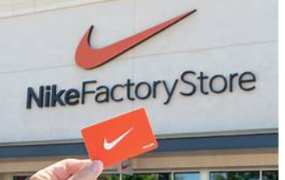
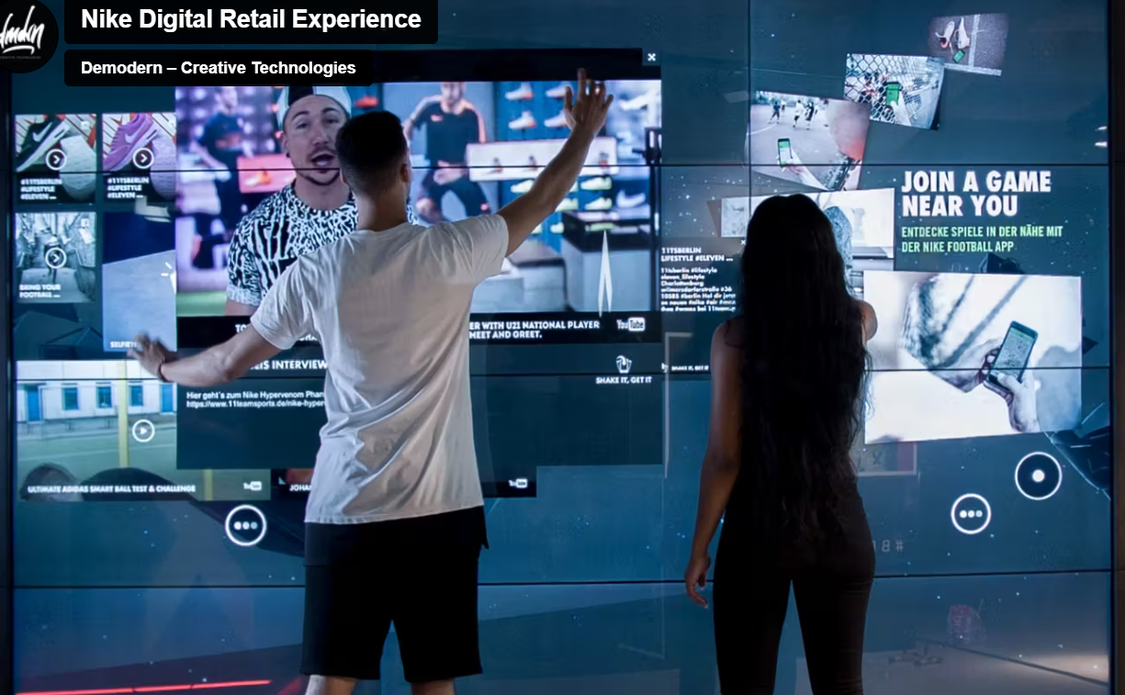
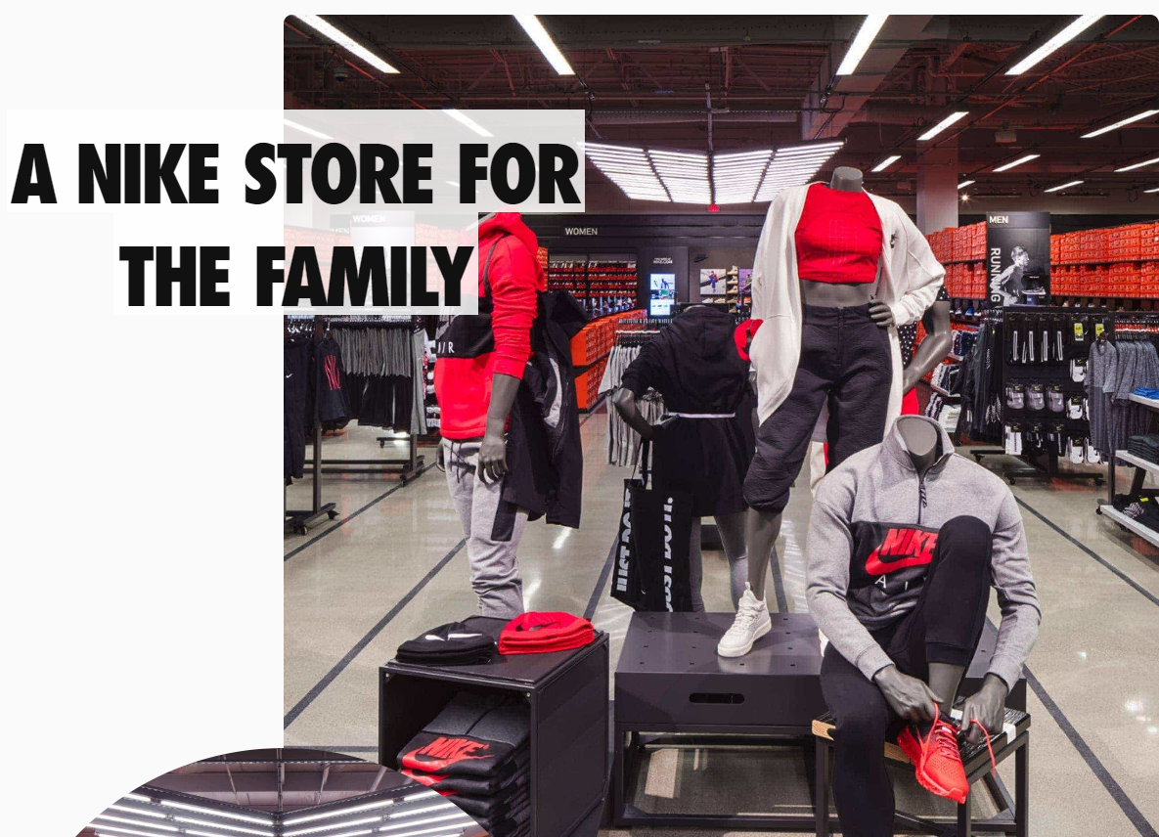
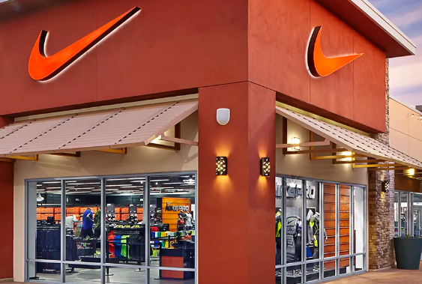
Place

Slide 90
Place/ Distribution Channels
In today's competitive marketplace, the key to success in making products available to target markets lies in strategic product placement and efficient distribution decisions. They are the cornerstones of making products available to target markets.
The place elements are crucial in ensuring that products reach their intended customers in a timely and convenient manner. Product placement involves strategically positioning products in locations where the target audience is likely to encounter them. This can include high-traffic retail stores, online marketplaces, and specific events.

Slide 91
Distribution decisions entail choosing the most suitable channels through which products will reach consumers.
Product placement involves strategically positioning products in locations where the target audience is likely to encounter them.
Options may include direct sales, partnering with retailers, wholesalers, or utilizing e-commerce platforms.
Making informed judgments about product placement and distribution ensures that the target market can access, see, and obtain the products.
Long-term success in the business environment depends on effective product distribution and positioning.

Slide 92
Place and Distribution Channels Are Affected by the Other "P's":
Product: Distribution channels are selected based on the nature and type of the product.
Price: Pricing strategy can determine which distribution channels are viable and cost-effective.
Promotion: Product placement and distribution can reinforce promotional efforts and increase visibility.
People: Understanding consumer preferences and buying behaviors helps tailor distribution strategies to meet customer needs.

Slide 93
Types of Distribution Channels
Channels can be:
Physical channels
Nike retail store
Distributors and wholesales
Third party
Call it spring/ Boutique spring!
Walmart
Footlocker

Slide 94
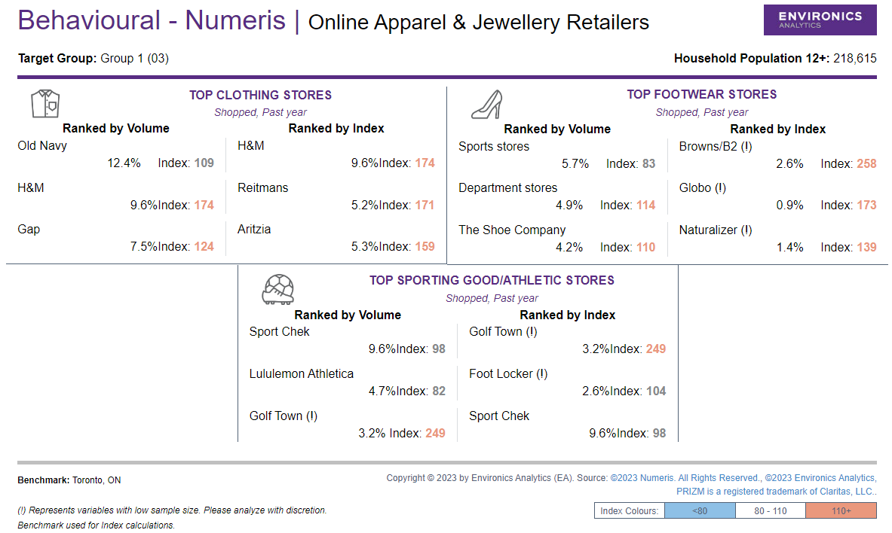
Online
Nike official website
Sports stores
The shoe company.
Department stores
When selecting a distribution channel for Nike running shoes in Toronto, Ontario, consideration should be given for the following factors to ensure the best fit:
Size - choose channels with a significant number of outlets in Toronto.
Number of product lines carried – this ensures that Nike running shoes receives and adequate attention and focus from the channel’s sales staff.
Strength of sales staff – partner with distribution channel and that have skilled and knowledgeable sales team.
4. Market coverage – consider local and nearby market coverage.
5. Reputation and image in the market – collaborate with reputable channels in the aesthetic footwear market.
6. Overall fit with your product – ensure channels align with Nike’s brand identity in Toronto.

Slide 95
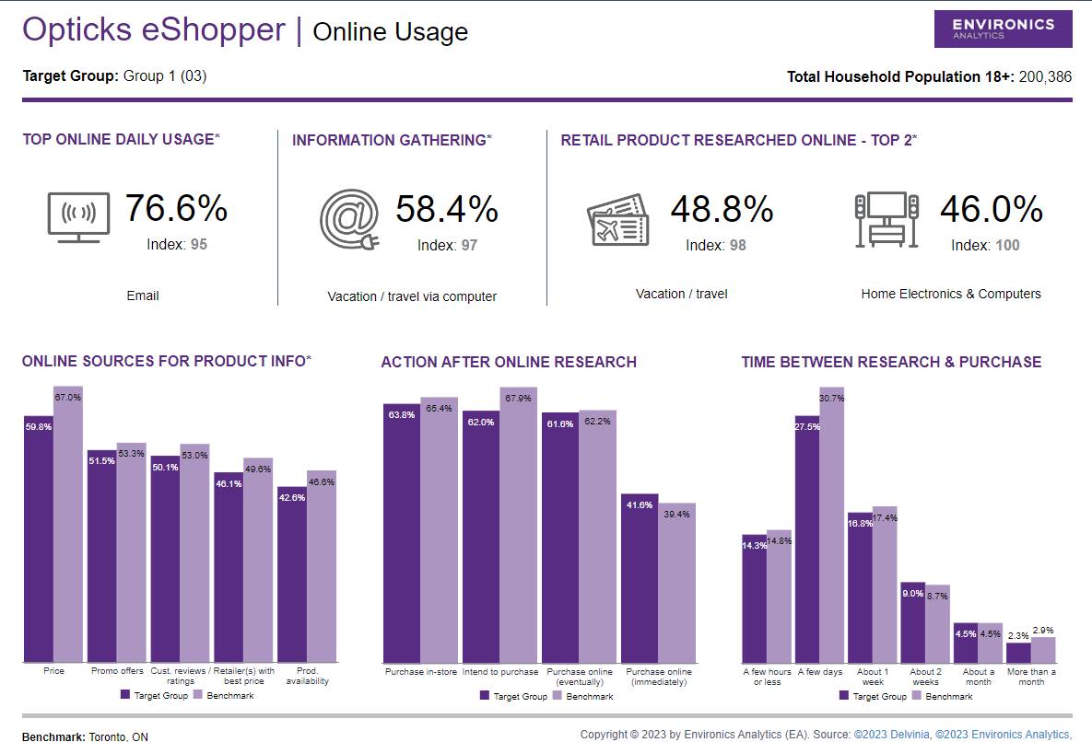
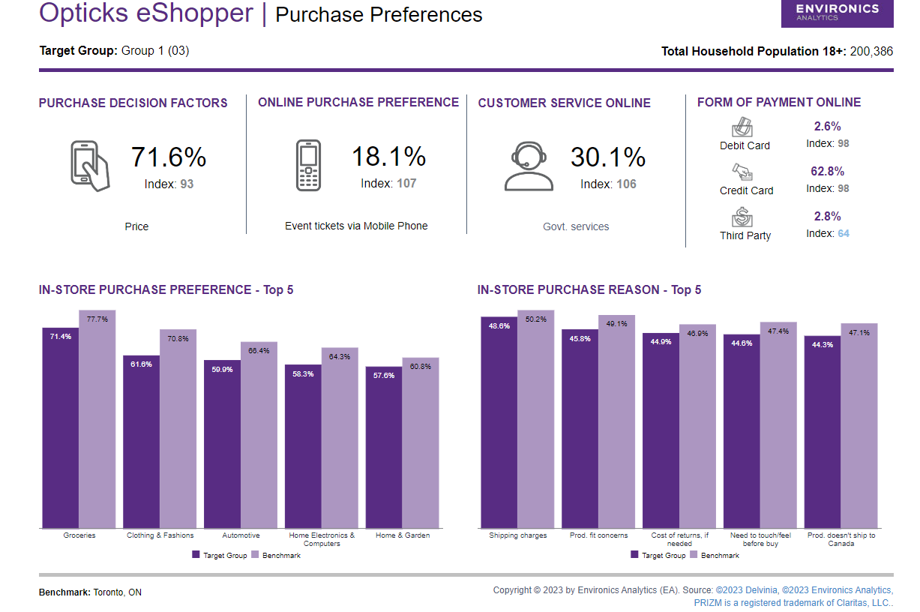
Rationale and placement strategy based on the envision data:
Strategy –
Nike's multi-channel distribution strategy, blending physical and online channels, ensures wide availability, convenience, and resonance with Toronto's runners and fitness enthusiasts.

Slide 96
Rationale and placement strategy based on the envision data:
Strategy –
Nike's multi-channel distribution strategy, blending physical and online channels, ensures wide availability, convenience, and resonance with Toronto's runners and fitness enthusiasts.

Slide 97
Physical channels –
Nike retail stores – expanding the Nike retail stores across high-traffic regions across Toronto. These will cater to in-person information gathering but also reinforce the brand's identity by providing a premium, immersive shopping experience.
Specialized athletic retailers - Strengthen partnerships with specialized athletic retailers like Footlocker and Boutique Spring, Walmart. These retailers align with the target audience's preferences and offer knowledgeable sales staff, enhancing the purchase experience.
2. Local events – participate in local athletic events to create direct engagement with potential customers and increase product/brand visibility

Slide 98
Rationale-
In-person preference – there is a strong inclination toward in-person purchase preference (61.7%). By increasing the numbers of Nike retail stores collaborating with specialized retailers the brand capitalizes on these preferences and provides a hands-on experience for customers.
The reasons for in-person preference are: -
Shipping charges
Production fit concerns
Need to touch feel before buying.
Shipping issues to their locations.

Slide 99
3. Customer service – shopping directly from retail stores provides better customer service (50.9%) as compared to online purchases (22.8%).
4. Online channels: - In today’s digital landscape online/ digital presence of a brand plays an important role in effectively connecting with their audience/ customers and this holds for Nike as well.
A strong online footprint enables Nike to engage with its customers, showcase its products, and create a seamless shopping experience that aligns with modern consumer behaviors.
5. Nike official website – optimizing the Nike official website for a seamless online shopping experience and it will cater to online information and purchase preferences.
Sports retailer’s online platform- a collaboration with other retailers like the shoe company, and sports stores.
6. Localized online marketing - Implement targeted online marketing campaigns focused on Toronto and nearby areas.

Slide 100
Rationale- online purchase preference-
Customers tend to visit online platforms for various information before making their purchasing decisions which are: -
Price
Promo offers.
Customer reviews/rating
Retailers with the best price
Product availability

Slide 101
The overall rationale for Placement strategy – The suggested strategy is giving buyers several ways to interact with Nike running shoes. Nike makes sure that customers can access product information and make purchases through the channels of their choice by deliberately deciding which physical and online distribution channels to use and by aligning with in-person and online preferences.
Additionally, the strategy maintains focus on critical factors such as size, product line attention, sales staff quality, market coverage, reputation, and brand fit.
Through this comprehensive distribution strategy, Nike aims to improve brand loyalty, provide a better consumer experience, and expand the market share of their running shoes in Toronto, Ontario.

Slide 102
Promotion

Slide 103
The goal of Nike's Communication Plan
Position the brand as a leader in innovative athletic footwear and apparel.
Cater to the evolving preferences of health-conscious consumers and foster a strong connection with the younger generation (Gen Z and Millennials).
Embrace sustainability as a core value, reflecting Nike's commitment to environmentally responsible practices.
Increase brand awareness and recognition among the target audience.
Drive higher engagement and interaction with the brand across various platforms.
Boost sales of Nike's next-generation running shoe by effectively communicating its unique features and benefits to the target audience.

Slide 104
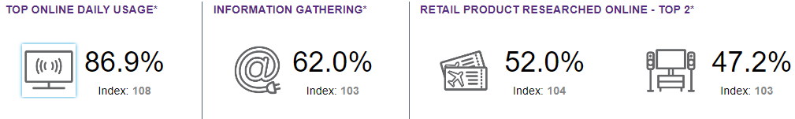
Messaging Rationale
Focus on Nike's unique selling proposition (USP): running shoes offering maximum comfort, durability, and style.
Aligned with the values and preferences of the target audience, as identified through Envision's data.
Highlight Nike's commitment to sustainability, resonating with the environmentally conscious preferences of health-conscious consumers.
High online daily usage index (86.9%) highlights the effectiveness of digital advertising and email campaigns.
Emphasis on information gathering and online product research (62.0% and 52.0%) supports Nike's strategy of providing detailed information and reviews.

Slide 105
Marketing Mix and Rationale
Advertising:
Television and Digital Advertising: Given the high online daily usage index, prioritize digital platforms for advertising to reach the target audience where they spend most of their time. Consider video ads that highlight the key features of Nike's running shoes.
Content Partnerships: Collaborate with health and fitness influencers who resonate with the target audience's interests, using the benchmark data on online sources for product information.

Slide 106
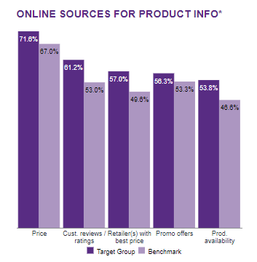
Marketing Mix and Rationale
Social Media Engagement:
Content Strategy: Leverage the values of information gathering and online product research to create informative and engaging social media content. Share customer reviews, ratings, and detailed product information, addressing the audience's preference for in-depth research.
Interactive Campaigns: Utilize social media to launch interactive campaigns such as polls, challenges, and quizzes that align with the audience's interests in health and travel.

Slide 107
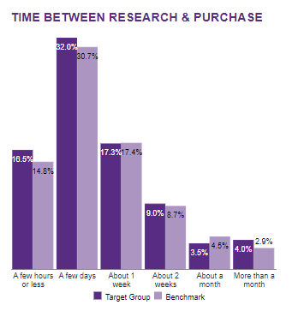
Marketing Mix and Rationale
Sales Promotion:
Limited-Time Offers: Utilize the benchmark data on time between research and purchase to strategically time limited-time offers. Since a significant portion of the audience intends to purchase within a few days or a week, align promotions with this timeframe.

Slide 108
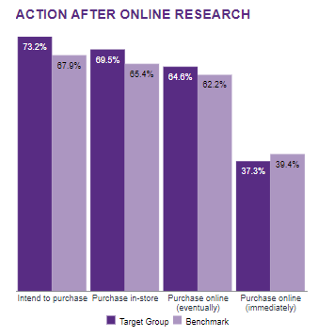
Marketing Mix and Rationale
Sales Promotion:
Flash Sales: Leverage the immediate online purchase intention index (62.2%) to introduce flash sales that encourage quick online purchases.

Slide 109
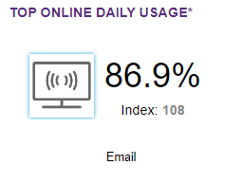
Marketing Mix and Rationale
Direct Marketing:
Email Campaigns: Capitalize on the high index for email usage to implement targeted email campaigns. Send emails with personalized product recommendations, highlighting promo offers and product availability.
Abandoned Cart Emails: Use email retargeting to remind customers who have shown purchase intent but haven't completed their transactions.

Slide 110
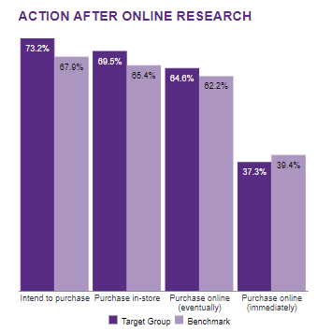
Marketing Mix and Rationale
Digital Marketing:
Social Media Advertising: With a majority of the audience intending to purchase online eventually (65.4%), allocate a portion of the budget to social media ads that encourage immediate online purchasing.
Retargeting Ads: Implement retargeting ads to reach users who have visited Nike's website but haven't made a purchase yet.

Slide 111
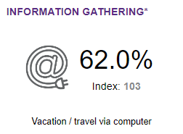
Marketing Mix and Rationale
Event Marketing:
Virtual Workshops: Leverage the high index for online vacation/travel research to offer virtual workshops that provide fitness and travel-related content, showcasing the versatility of Nike's products.
Influencer Takeovers: Collaborate with fitness and travel influencers to host virtual events that align with the audience's interests, allowing them to interact with the influencers and the brand.

Slide 112
Rationale
Strategy: Social Media Engagement
Broad Audience Reach: Target audience, including Gen Z and Millennials, are highly active on social media platforms, providing a vast reach for Nike's running shoe promotions.
High Online Daily Usage: The audience's significant online daily usage index (86.9%) makes social media an ideal channel for brand engagement and message delivery.
Alignment with Information Gathering: The emphasis on information gathering and online research (62.0% and 52.0% respectively) aligns with social media's ability to provide detailed product information and reviews.
Digital Advertising Effectiveness: The digitally engaged audience is more receptive to digital advertising, making social media campaigns a powerful tool for promoting Nike running shoes.
Sustainability Emphasis: Seamlessly integrate sustainability messaging into social media content, resonating with the environmentally conscious preferences of health-conscious consumers and fostering a positive brand image.

Slide 113
Conclusion
Strategic Alignment: By harnessing the insights from Envision's data, Nike's communication strategies are meticulously tailored to resonate with the values and behaviors of the target audience.
Digital Engagement Focus: The strategies strategically cater to the digital engagement habits and online research tendencies of the audience, fostering meaningful interactions and enhancing the brand's online presence.
Driving Growth: This comprehensive approach effectively engages potential customers, addresses their preferences, and ultimately contributes to the realization of Nike's growth objectives in the dynamic athletic footwear and apparel market.

Slide 114
Develop a New Nike Running Shoe Product Develop the Nike GreenStride Runner. A next-generation running shoe that provides great performance, unsurpassed comfort, and more sustainability while accommodating to changing demands and preferences of running sportspersons and health-conscious customers.
Conclusion

Slide 115
Thank you
FROM TEAM 4
Kunfayat Adekanmbi
Neeraj Mehta
Sindhu Chakravaram
Shola Fabiyi

Slide 116
Variable 1: Sports & Leisure Overview – Attend
Top Local Attractions & Destinations:
Other leisure activities​
Historical sites
Carnivals/fairs
This group has a representation a little above average (13.8%) when measured against the benchmark (Index: 95).
This reveals a moderate interest in visiting carnivals and fairs as part of their leisure activities
The target group has a depiction slightly above average (13.6%) when related to the benchmark (Index: 94). This shows a fair interest in visiting historical sites, implying a desire for cultural enrichment and appreciation.
The target group has a somewhat high representation (21.1%) when related to the benchmark (Index: 100).
This implies that they actively engage in diverse leisure activities beyond the specific categories mentioned, indicating varying and well-rounded lifestyles.

